Slide 1
Earth Observation Engineering Systems
Data Cubes

Slide 2
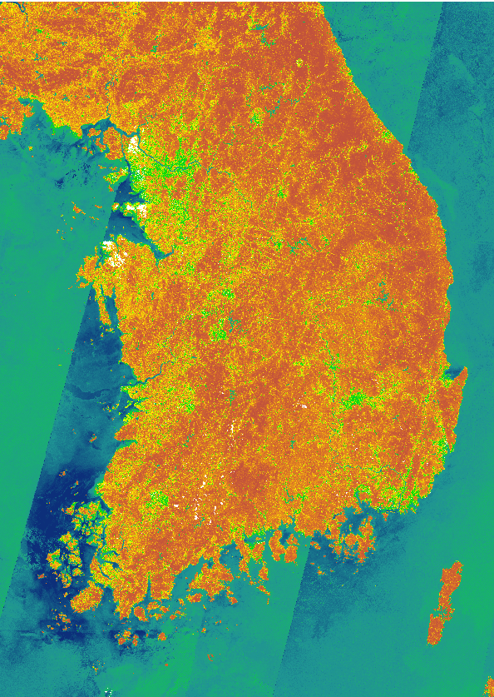
CAP Motivation: Opportunity and Necessity
The Common Agricultural Policy (CAP) has set out to implement radical changes towards fairer, greener and more performance-based policies.
Thus, CAP aims at the large scale and frequent monitoring of agricultural land.
Towards this effort, the Sentinel satellite missions, advanced ICT technologies and Artificial Intelligence (AI) have been identified as key enablers.
CAP monitoring systems need to be able to process and visualize large amounts of big satellite data, which is not possible using traditional local storage and processing workflows, and for this reason big Earth Observation (EO) management technologies are necessitated.

Slide 3
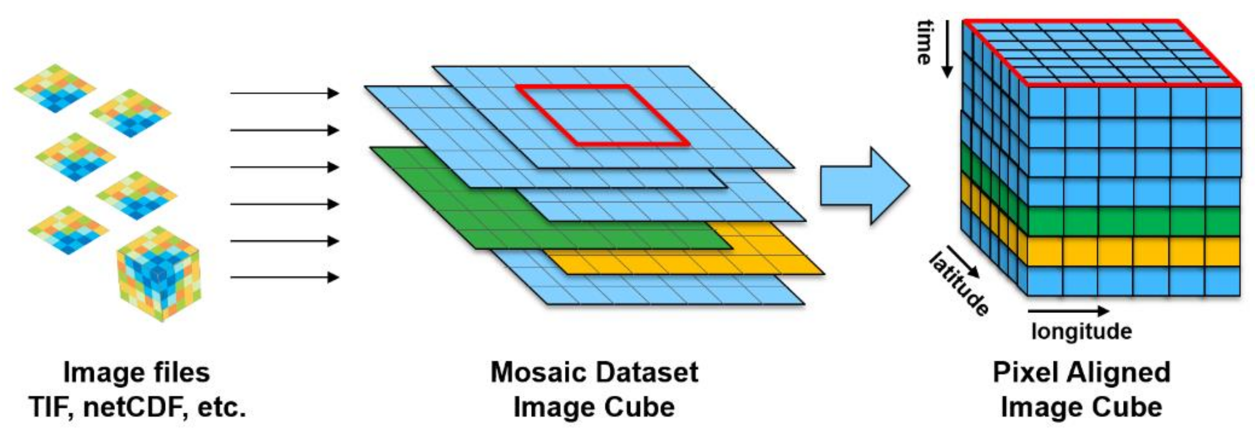
Introduction to Data Cubes
Users need to handle hundreds (or thousands) of EO data files, of different spectral, temporal and spatial resolutions
New approaches are required for the management, analysis and distribution of Earth observation data and products in order to meet big data challenges and to reduce the need of special skills such as advanced SQL queries.
The Data Cube was originally implemented as regular, non-overlapping, ‘tiles’ of gridded sensor data, ‘stacked’ according to the time of data capture (observation), leading to the visual metaphor of a ‘cube’ of data
Datacubes are emerging as a paradigm which allows offering massive spatio-temporal data more in a more homogenized and better to analyze fashion, in particular when it comes to mixed spatial and temporal evaluation

Slide 4
The data cube solution
Data Cube
As an installed module (e.g. Open Data Cube)
As a service (e.g. Mundi DIAS)
Data cubes are considered more a philosophy than a
clearly defined technology.
Definition
Geospatial Analytics
Multi-dimensional ("n-D") array of values with at least one dimension of spatial or temporal definition.
EO data have typically three dimensions: lat, lon and time
Simplicity on generating time series of observation over an area of interest
Efficient trimming and slicing along any number of axes from the data cube in a single request
Why a data cube
Various datasets
Easier to organize the data
Simplification of data management
Improvement of time performance regarding queries
Simple to generate mapping context
Several processing steps such as reprojection, scaling, mosaicking, are offered as build-in functions
Raw Satellite data
Processed Satellite Data
Indices derived from satellite data either pre computed or computed on the fly
Meteorological Data
Copernicus Services
Features Engineering
Simple to build a feature space ready to be used as input in AI pipelines
Build in Machine Learning function
Notes:
© Copyright PresentationGo.com – The free PowerPoint template library

Slide 5
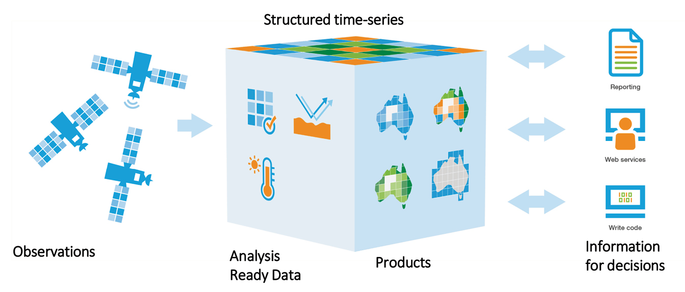
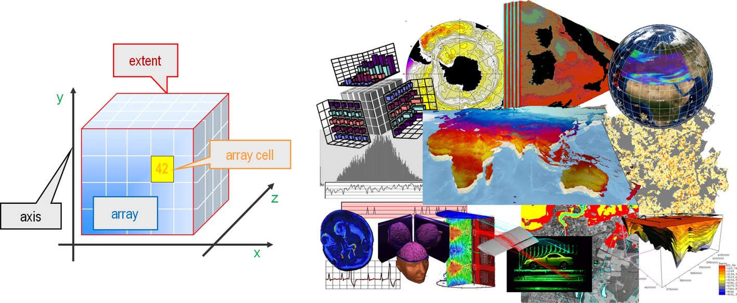
Datacube Technologies
Three categories of datacube technologies:
Array Database Systems
Virtual Data Cubes
Open Data Cube
An Array Database System is characterized by offering standard database services on massive n-D arrays.
They are a class of No-SQL databases that store, manage, and analyze data whose natural structures are arrays.
Specialize in the storage, retrieval, and processing of n-dimensional data.
Array Databases

Slide 6
Knows Array Database Systems - Rasdaman
RASDAMAN conceptual model consists of multidimensional arrays with n-dimensions extend and cell type. Data storage relies on partitioning of the arrays into sub-arrays called tiles, which can be storage either in a relational database, in files in the data systems or archives of files that can be accessed externally.
It has been successfully used for managing data in a variety of applications within the EarthServer project
Besides image processing, demonstrated analyses have been computationally rather simple and do not go beyond selection, aggregation, resampling, or calculation of simple statistics.
Based on scalable parallel “tile streaming” architecture
Only the enterprise version of RasDaMan can be extended to multiple instances or nodes

Slide 7
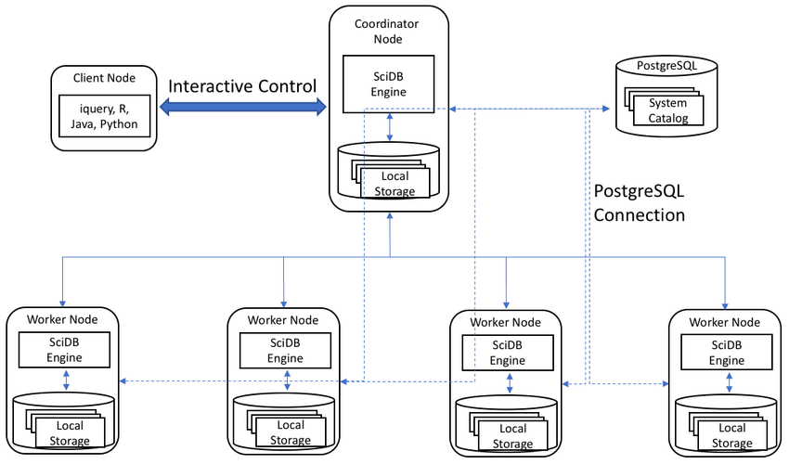
Knows Array Database Systems - SciDB
It is a column-oriented database management system designed for multidimensional data management and analytics common to scientific, geospatial, financial, and industrial applications.
SciDB implements the array model and pays special attention to scalable processing. Arrays are partitioned into equally sized chunks.
Chunks are distributed over database instances, which may run on different physical machines in a shared-nothing cluster computing environment

Slide 8
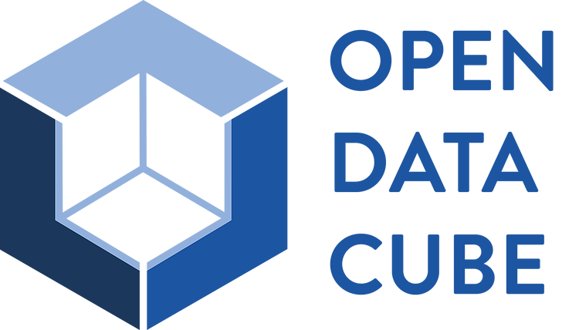
Datacube Technologies: ODC
The Open Data Cube (ODC) is an analytical framework composed of a series of data structures and tools that facilitate the organization and analysis of EO data.
It is available under Apache 2.0 license as a suite of applications
ODC allows the cataloging of massive EO data sets and their access and manipulation through a set of command line tools and a Python API.
The source code of ODC and its tools are open and are officially distributed through dozens of git repositories
The main module responsible for data indexing is called datacube-core and consists of a Python script set that uses a PostgreSQL database to catalog the metadata of the data and provides an API for data retrieval.
ODC can index data stored on a file system or the web

Slide 9
Advantages of ODC
Focused on Analysis Ready Data (ARD) to reduce data preparation time and complexity; easy for users
Based on free and open source software
Enables data interoperability, easy exploratory data Analysis and efficient time series analyses
Proven concept; Working in Australia, Colombia, Switzerland, Vietnam and 5 countries in Africa and many others under development
Easily deployed in a cloud or a local computer
Data in multi dimensional arrays (latitude, longitude, time…) along with a Python based API for high performance querying and data access (especially over a time series)
Allow scalable continent scale processing
of the stored data
Existing customizable web-based user interface
and a library of application algorithms

Slide 10
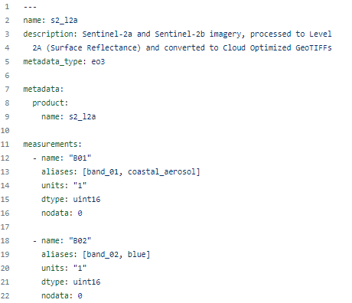
Datacube Technologies: ODC
ODC uses the concepts of Product and Dataset to represent the data indexed in its catalog.
Products are collections of data sets that share the same set of measures and some subsets of metadata.
The Dataset represents the smallest independently described, inventoried and managed data aggregation. These are usually scenes stored in files that together represent a Product

Slide 11
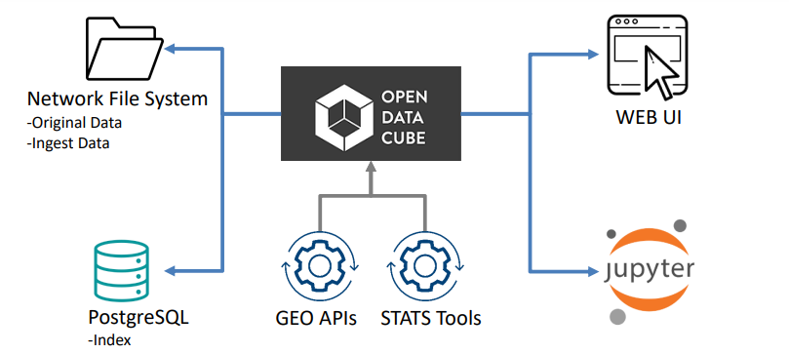
Data Loading in ODC
https://medium.com/opendatacube/what-is-open-data-cube-805af60820d7

Slide 12
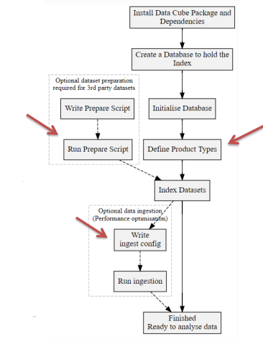
Data Loading in ODC
Step 1: A Product must be registered from its metadata.
Step 2: the metadata is extracted from each file (Dataset) that will be linked to the Product.
Step 3: With the metadata of the prepared files, the third step is to register these Datasets in the ODC catalog.
Step 4: The last step, called data ingestion, is optional and deals with the process of creating new Datasets from already registered Datasets. These new Datasets is saved using a new storage scheme, composing a new Product. At this stage, data can be re-sampled, re-organized in time series and/or broken into smaller blocks for storage. The main purpose of producing these new Datasets is to optimize the data format to speed up the reading process of data in the file system.

Slide 13
Indexing and Ingestion
Indexing is the entire process of adding new metadata for a product to the Data Cube
Ingestion is the entire process of adding new data to the Data Cube.
Both process include:
Describing your source dataset in a well-defined schema(.yaml)
Creating a script for each dataset to generate a metadata file(.yaml).
Ingestion additionally include:
Creating an ingestion configuration file that defines the input dataset type and the output characteristics

Slide 14
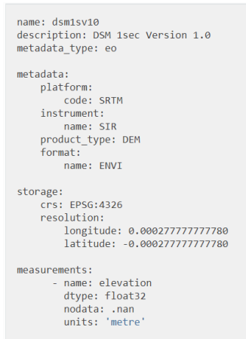
Product definition
Defines some of the metadata common to all the datasets.
We have created multiple products based on our needs:
Sentinel-2 raw
Sentinel-2 preprocessed
Sentinel-1 BackScatter
Sentinel-1 Coherence
LPIS
$ datacube product add product.yaml

Slide 15
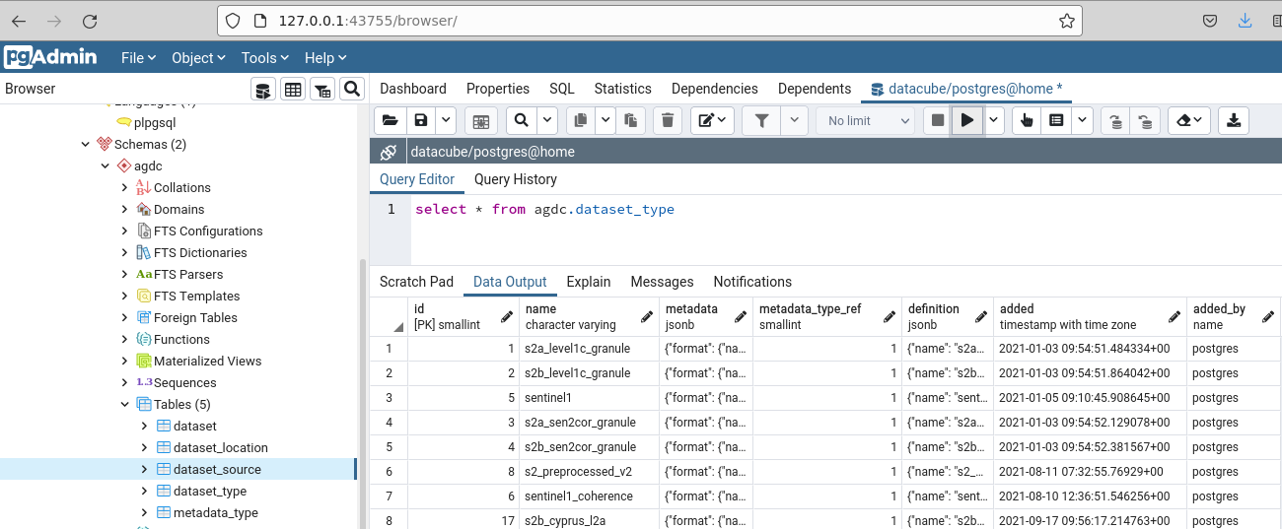
Products in Database

Slide 16
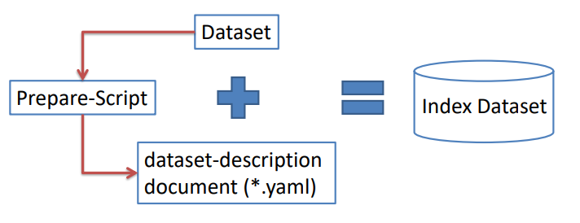
Dataset Preparation Scripts & Indexing
Next step is to create files that describe each dataset.
Thus, preparation python script read satellite data and identify its attributes.
Based on this metadata, a .yaml file is created for each image.
Finally, the metadata is indexed in the database based on the following commands:
$ datacube dataset add datasetXIndexing.yaml

Slide 17
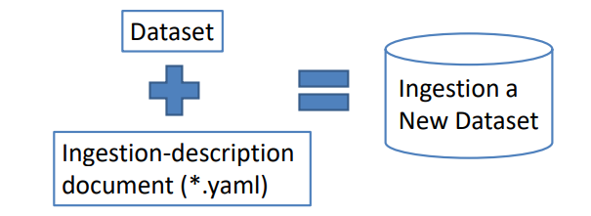
Dataset Ingestion
Ingestion configuration file
defining a transformation between the source dataset and the output dataset.
Using the ingestion process to define a bounding box, a resolution, projection and tile size.
$ datacube ingest -c datasetXIngestion.yaml

Slide 18
Indexing or Ingestion
From the developers of ODC:
Ingestion is no longer recommended. While it was used as an optimised on-disk storage mechanism, there are a range of reasons why this is no longer ideal. For example the emergence of cloud optimised storage formats means that software such as GDAL and Rasterio are optimised for reading many files over the network. Additionally the limitation of NetCDF reading to a single thread means that reading from .TIF files on disk could be faster in some situations.
In addition to limited performance improvements, ingestion leads to duplication of data and opinionated decisions, such as reprojection of data, which can lead to a loss of data fidelity.
NOA Strategy
Currently, we prefer indexing of data combined with pre-proccesed GeoTIFFs

Slide 19
Accessing Data – The Python API
The development of applications for processing data indexed by an ODC instance requires the use of the framework’s Python API.
This API allows the listing of indexed Products, retrieving Products and Datasets data and metadata.
Data retrieval is performed by a load function that receives parameters such as product name, bounding box, period range, and spatial output resolution.
This function returns a xarray object to be used by user’s application.
For parallelization of processing, ODC has examples of using asynchronous task queues through the use of the Celery framework. Nevertheless, the parallelization of the processing of applications using ODC is the responsibility of the user.

Slide 20
The power of Xarray
Python has emerged as a leading programing language for both the physical sciences and data sciences.
At the core of modern scientific computing and analysis in Python are the NumPy and SciPy packages, which provide a robust N-dimensional array object and the fundamental operations required for science and engineering applications.
Pandas library has been used in data science and business analytics, whereas the DataFrame and Series objects provide unparalleled analysis tools for data alignment, resampling, grouping, pivoting, and aggregation in Python.
Xarray implements data structures and an analytics toolkit for multi-dimensional labeled arrays strongly inspired by pandas.
While pandas includes a data structure called the Panel for three dimensional data, its fixed rank design make it unsuitable for applications that require arbitrary rank arrays.
Additionally, many of the features that make the pandas DataFrame and Series objects so useful, are not fully available on the Panel.

Slide 22
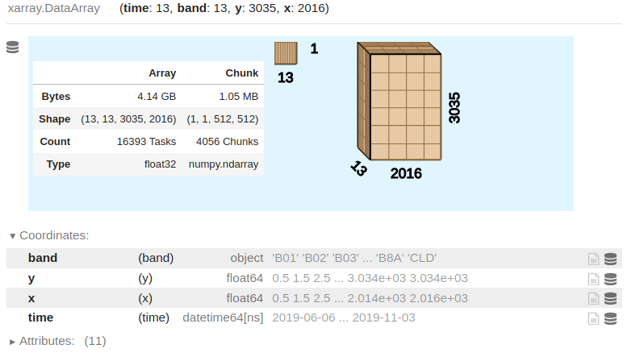
The power of Xarray

Slide 23
The power of Xarray
xarray features two main data structures: the DataArray and the Dataset.
The DataArray is xarray’s implementation of a labeled, multi-dimensional array. It has several key properties:
data: N-dimensional array (NumPy or dask) holding the array's values,
coords: dict-like container of arrays (coordinates) that label each point (e.g., 1-dimensional arrays of numbers, datetime objects or strings),
dims: dimension names for each axis [e.g., (‘time’, ‘latitude’, ‘longitude’)],
attrs: OrderedDict holding arbitrary metadata (e.g. units or descriptions), and
name: an arbitrary name for the array.

Slide 24
The power of Xarray
The Dataset is xarray’s multi-dimensional equivalent of a DataFrame.
It is a dict-like container of labeled arrays (DataArrays) with aligned dimensions. It is designed as an in-memory representation of a netCDF dataset.
In addition to the dict-like interface of the dataset itself, which can be used to access any DataArray in a Dataset, datasets have four key properties:
data_vars: OrderedDict of DataArray objects corresponding to data variables,
coords: OrderedDict of DataArray objects intended to label points used in data_vars (e.g., 1-dimensional arrays of numbers, datetime objects or strings),
dims: dictionary mapping from dimension names to the fixed length of each dimension (e.g., {‘x’: 6, ‘y’: 6, ‘time’: 8}), and
attrs: OrderedDict to hold arbitrary metadata pertaining to the dataset.

Slide 25
The power of Xarray
Example on meteorological data

Slide 26
The power of Xarray
xarray includes a powerful and growing feature set. The following list highlights some of the key features available in xarray. The xarray documentation includes a complete description of available features and their usage.
Label-based indexing: Similarly to pandas objects, xarray objects support both integer- and label-based lookups along each dimension.
Arithmetic: arithmetic between xarray objects vectorizes based on dimension names, automatically looping (broadcasting) over each distinct dimension.
Aggregation: calculation of statistics (e.g. sum) along a dimension of an xarray object can be done by dimension name instead of an integer axis number.
Alignment: xarray supports database-like join operations for combining xarray objects along common coordinates.
Split-apply-combine: xarray includes N-dimensional grouped operations implementing the split-apply-combine strategy

Slide 27
The power of Xarray
Resampling and rolling window operations: Utilizing the efficient resampling methods from pandas and rolling window operations from Bottleneck, xarray offers a robust set of resampling and rolling window operations along a single dimension.
Plotting: xarray plotting functionality is a thin wrapper around the popular Matplotlib library. xarray uses the syntax and function names from Matplotlib whenever possible, resulting in a seamless transition between the two.
Missing Data: xarray smoothly handles missing data in all operations, including arithmetic, alignment and aggregation.
Out-of-core computation: xarray’s data structures can be backed by dask instead of NumPy to support parallel and streaming computation on data that does not fit into memory, up to 100s of GB or TBs in size. Such large datasets (“big data”) are increasingly prevalent in science.

Slide 28
Example using xarray
In [4]: data = xr.DataArray(np.random.randn(2, 3), dims=("x", "y"), coords={"x": [10, 20]})
In [5]: data
Out[5]: <xarray.DataArray (x: 2, y: 3)> array([[ 0.4691123 , -0.28286334, -1.5090585 ], [-1.13563237, 1.21211203, -0.17321465]]) Coordinates: * x (x) int64 10 20 Dimensions without coordinates: y
In [6]: xr.DataArray(pd.Series(range(3), index=list("abc"), name="foo"))
Out[6]: <xarray.DataArray 'foo' (dim_0: 3)> array([0, 1, 2]) Coordinates: * dim_0 (dim_0) object 'a' 'b' 'c'
In [7]: data.values
Out[7]: array([[ 0.4691123 , -0.28286334, -1.5090585 ], [-1.13563237, 1.21211203, -0.17321465]])
In [8]: data.dims
Out[8]: ('x', 'y')
In [9]: data.coords
Out[9]: Coordinates: * x (x) int64 10 20 # you can use this dictionary to store arbitrary metadata

Slide 29
Example using xarray
In [21]: data + 10
Out[21]: <xarray.DataArray (x: 2, y: 3)> array([[10.4691123 , 9.71713666, 8.4909415 ], [ 8.86436763, 11.21211203, 9.82678535]]) Coordinates: * x (x) int64 10 20 Dimensions without coordinates: y
In [22]: np.sin(data)
Out[22]: <xarray.DataArray (x: 2, y: 3)> array([[ 0.45209466, -0.27910634, -0.99809483], [-0.90680094, 0.9363595 , -0.17234978]]) Coordinates: * x (x) int64 10 20 Dimensions without coordinates: y Attributes: long_name: random velocity units: metres/sec description: A random variable created as an example. random_attribute: 123
In [23]: data.T
Out[23]: <xarray.DataArray (y: 3, x: 2)> array([[ 0.4691123 , -1.13563237], [-0.28286334, 1.21211203], [-1.5090585 , -0.17321465]]) Coordinates: * x (x) int64 10 20 Dimensions without coordinates: y Attributes: long_name: random velocity units: metres/sec description: A random variable created as an example. random_attribute: 123
In [24]: data.sum()
Out[24]: <xarray.DataArray ()> array(-1.41954454)

Slide 30
The power of Xarray
Indexing
Dimension lookup | Index lookup | DataArray syntax | Dataset syntax
Positional | By integer | da[:, 0] | not available
Positional | By label | da.loc[:, 'IA'] | not available
By name | By integer | da.isel(space=0) or da[dict(space=0)] | ds.isel(space=0) or ds[dict(space=0)]
By name | By label | da.sel(space='IA') or da.loc[dict(space='IA')] | ds.sel(space='IA') or ds.loc[dict(space='IA')]

Slide 31
NDVI calculation
# Set the central latitude and longitude
central_lat = 32.83
central_lon = 34.81
# Set the buffer to load around the central coordinates
buffer = 0.03
# Compute the bounding box for the study area
study_area_lat = (central_lat - buffer, central_lat + buffer)
study_area_lon = (central_lon - buffer, central_lon + buffer)
# Set the data source - sentinel2_raw corresponds to Sentinel-2A
set_product = "sentinel2_raw"
# Set the date range to load data over
set_time = ("2018-01-01", "2018-02-01")
# Set the measurements/bands to load
set_measurements = ["green","nir"]
# Set the coordinate reference system and output resolution
set_crs = 'EPSG:3857'
set_resolution = (-10, 10)
dataset = dc.load(product=set_product,x=study_area_lon,y=study_area_lat, time=set_time,measurements=set_measurements,output_crs=set_crs,
resolution=set_resolution)
# Calculate the components that make up the NDVI calculation
band_diff = dataset.nir - dataset.red
band_sum = dataset.nir + dataset.red
# Calculate NDVI and store it as a measurement in the original dataset
ndvi = band_diff / band_sum

Slide 32
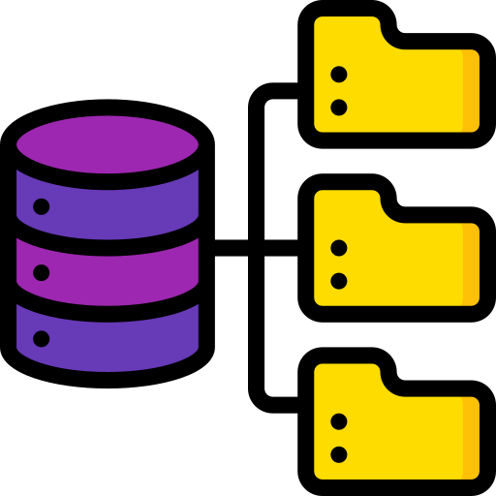
Implementations: Agricultural Monitoring Data Cubes (ADC)
We host three Agricultural Data Cubes in three different VMs, one of them hosted on cloud (CreoDIAS), with the latter to has direct access to the full archive of Sentinel images, without the need for downloading them.
Automated and scheduled pipelines search for new satellite images, pre-process them and generate resampled and re-projected Sentinel-1 and Sentinel-2 Cloud Optimized GeoTIFFs
Metadata of these files are indexed to a PostgreSQL, while actual data are stored in CreoDIAS VM
1
2
3
Discover Data
Pre-Process Data
Index New Products

Slide 33
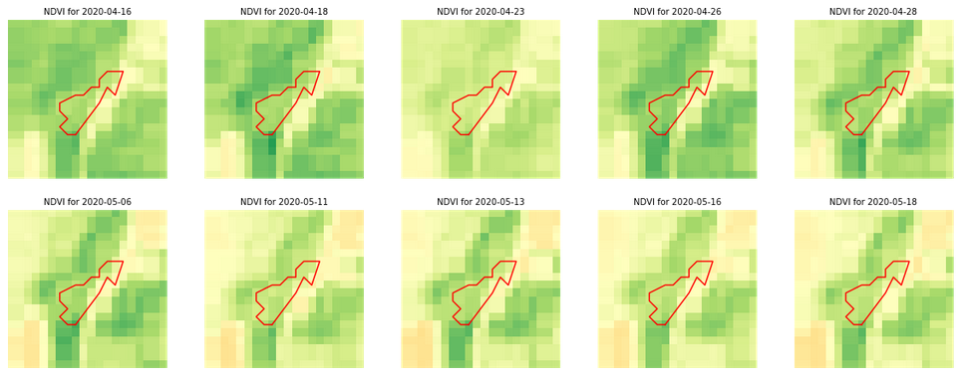
Current usage of ADC: High Level
Cloud-free Mosaics: Median, Geomedian, Max-NDVI et cetera
Spectral Indices: NDVI, NDMI, NBR, NDWI, SAVI, dNDVI etc.
Feature space creation for crop classification Monitoring soil erosion
Grassland mowing events detection
Identification of stubble burning

Slide 34
Current usage of ADC: Spatial Buffers
As parcels’ geometries for each country and year are indexed into the Data Cube, one can use our inward buffer functionality which can alleviate the adverse consequences of mixed pixels.
This way, we can extract only the representative information from the rest of the pixels encompassed inside the parcels’ buffered geometries
The Sen2Cor scene classification product has suboptimal recall for the cloud and shadow classes.
We additionally provide an adjustable outward buffer that can be applied on the less-than-perfect cloud and shadow mask products in order to reduce some of the noise.

Slide 35
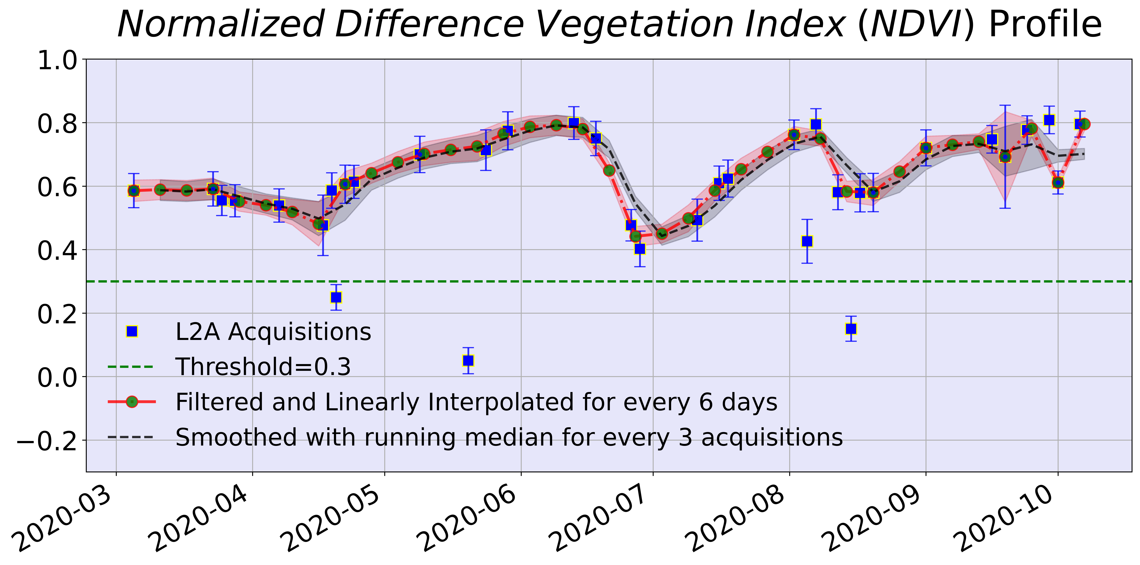
Current usage of ADC: SITS
ADC solution offers a number of SITS processing techniques to filter, interpolate, resample and smooth the pixel or parcel time-series.
For example filter we can filter out outliers and fill the missing values from clouds and shadows using a number of off-the-shelf interpolation techniques.
Interpolated SITS can then be sampled at any desired temporal resolution. This is useful when constructing feature spaces for machine learning tasks that require homogeneous input of fixed elements.
Additionally, our solution provides smoothing functionalities (e.g., rolling median) to eliminate the noise caused by temporal fluctuations on the SITS. Thus, patterns can be more clear and reveal trends throughout the years

Slide 36
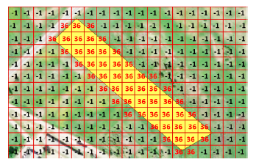
The ADC innovations: Efficient Zonal Statistics
Large scale monitoring (e.g. national scale) demands the statistics computation and the execution of geospatial queries for millions of parcels. To address this need:
Parcels’ geometries are rasterized and indexed also as an additional product in ADC
This addition enables the fast and parallel computation of zonal statistics per parcel using the groupby function, which groups the xarray dimensions based on the respective IDs
It is observed that for a large number of parcels, groupby is far more computationally economic opening the room for the effortless and efficient scaling up.

Slide 37
The ADC innovations: Scalable country-specific knowledge
The results of the downstream services that Data Cube supports are used to update a PostgreSQL/PostGIS database.
The database contains aggregated results per parcel, which can then be easily accessed, enabling a back-and-forth communication with the Data Cube.
Thus, we have a Data Cube that includes and keep on being dynamically populated by Sentinel-1 and Sentinel-2 products.
The Cube also hosts auxiliary geospatial data (e.g., LPIS) that are used to enable the provision high level data products (e.g., crop classification) that in turn populate the cubes.
This way, we end up with country specific knowledge bases for CAP monitoring

Slide 38
ADC and the outside world
Except from the internal usage of Data Cube, it can also be used directly from external users.
Data can be open-accessed so the pilot and other users exploit the simplified access for analysis and validation purposes.
Three examples are presented each of them showcasing different ways of exploiting the Data Cube
Successful Stories

Slide 39
Story 1: Time-Series Images on request
Remote Sensing supports decision-making by the experts.
To that direction, in-house or external systems are used for analyzing satellite images.
ENVISION Data Cube offers an API on top of it that accepts requests that include parcel id, time range and vegetation index / band.
Once the request is accepted, the back-end system generates time-series GeoTIFFs and pushes the results to user's repository.
Thus, decision-makers have an additional tool for the validation process.
External Users
ENVISION DC

Slide 40
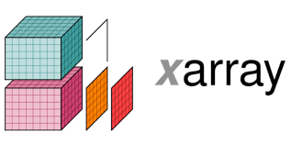
Story 2: Multidimensional Data on demand
Data scientists and developers may need directly access to the data instead of getting images.
Data Cube can be opened to authenticated users so to provide multidimensional data via xarrays for a requested area, date range and series of bands or/and indices.
This data are offered via the xpublish. Xpublish lets you easily publish Xarray Datasets via a REST API.
Under the hood, Xpublish is using FastAPI.
The data and/or metadata in the Xarray Datasets can be exposed in various forms through pluggable REST API endpoints.
Efficient, on-demand delivery of large datasets may be enabled with Dask on the server-side.
xpublish

Slide 41
Story 3: The DataCAP Web App
Having data and parcels indexed in the Data Cube, opens the room from various applications to be implemented.
A Django web application has been developed serving crop classification and grassland mowing results for a series of parcels.
In addition, it allows user to enter visualization parameters so the requested satellite images can be plotted.
At the same time, Street Level Images are also visualized to enhance the inspection of crop classification and grassland mowing results.

Slide 42
Lesson learned from using ODC
Analysis Ready Data (ARD) has become an expectation rather than a desire from users
Production and access to global ARD is not an easy process.
The download or/and upload of EO data is important to be avoided as as file sizes are becoming increasingly larger for satellite data.
Local solutions may be better in some cases
Not all the users have the required skills to handle databases and develop scripts. Thus, the idea of an API with minimum need for coding seems ideal.

Slide 43
Thank you!
AgriHub, IAASARS, NOA
+30 210 34 90 125
akoukos@noa.gr, tdrivas@noa.gr
http://beyond-eocenter.eu/

